Slide 1
Advanced higher Graphic communication
Computer Aided Design (CAD) – Boolean Functions

Slide 2
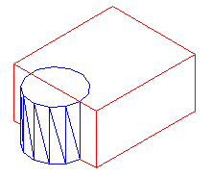
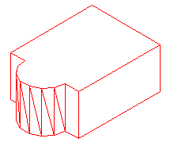
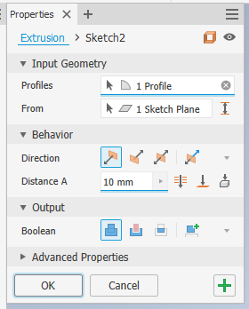
Boolean Function - ADD
What is it?
The Boolean Add function allows the user to combine the total volume of two or more solids or two or more regions into a composite object.
In simple terms in Inventor it is using the Join command to combine two solids into one shape.
When answering questions for an exam use the ADD command not the JOIN.

Slide 3
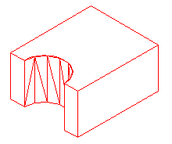
Boolean Function - Subtract
What is it?
The Boolean function of Subtract allows the user to remove one volume of two solids or one of two or more regions into a composite objects.
In simple terms in Inventor it is using the CUT command to subtract a solid from another solid shape.
When answering questions for an exam use the SUBTRACT command not CUT.

Slide 4
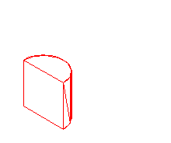
Boolean function - Intersect
What is it?
Intersect allows the user to create a composite solid from the common volume of two or more overlapping solids. INTERSCT removes the non-overlapping portions and creates a composite solid from the common volume.

